Slide 1
Personal Movie Blog
Project Proto-type

Slide 2
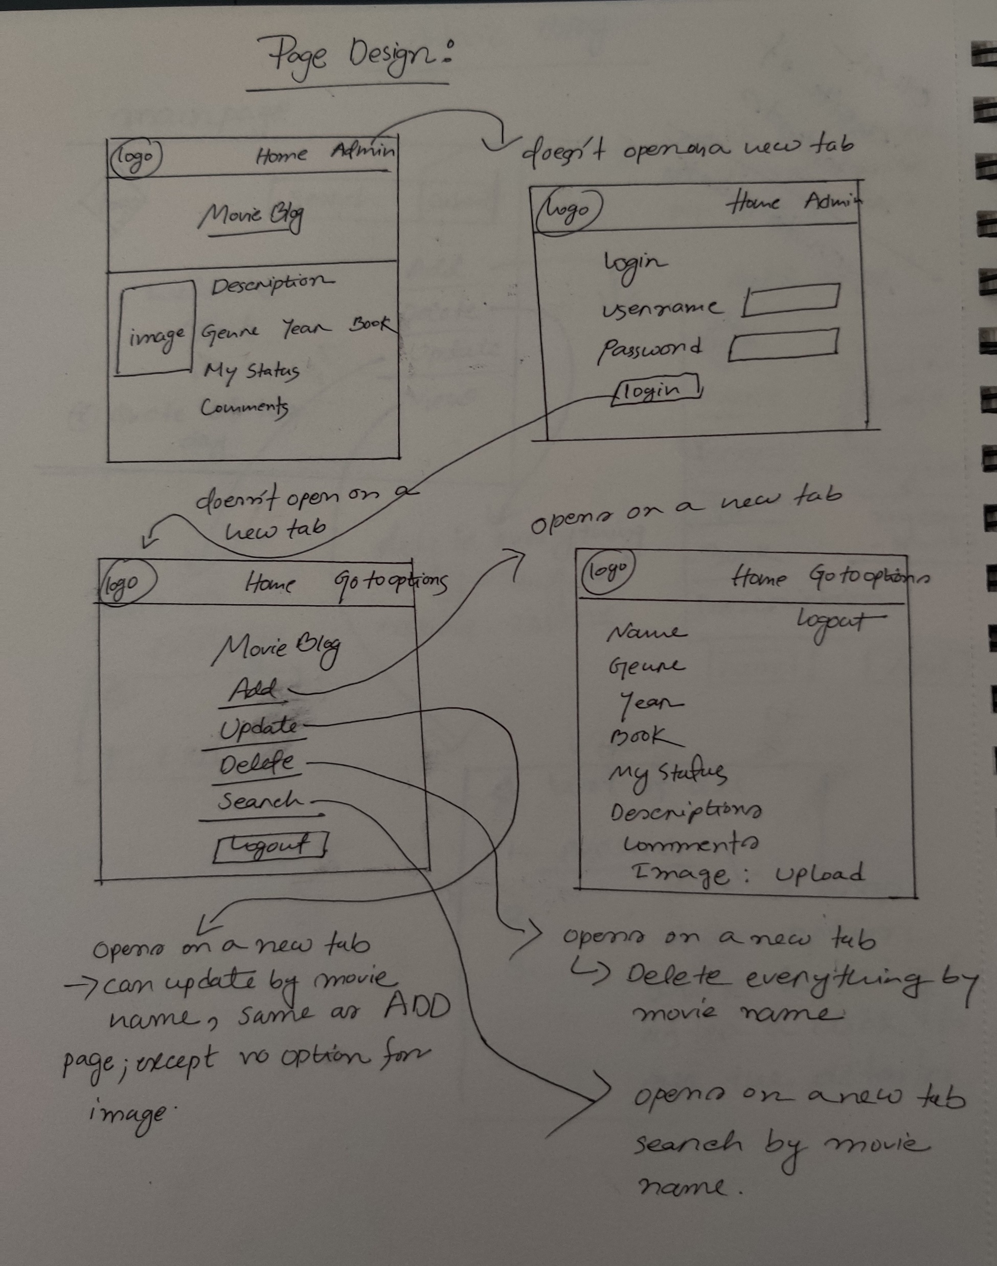
Frontend

Slide 3
Backend
For now, there will be only one table that will store the Movie name, type, genre, book, description, image/file name, my status, my comments attributes.
I’ll use MariaDB via php to store the information.
I’ll work on the page design first then I’ll be working with JS and database at the same time. So, some tables may change or will be added.

Slide 4
Basic functionalities
Home page : will contain movie details, only viewers can access this page; for now no options for search result for the viewers. This page will have an option to log in as an Admin.
Log in : Only admin can log in with a given username and password, no option to register.
Main page : after login, admin can select options to add, update, delete, search.
Add page : can add movie name, genre, type, book, description, my status, my comments, movie image.
Update page : same as add page, can be updated any info except the image by the movie name.
Delete page : can be deleted all information about a movie only by its name.
Search page : can search for a movie from the database and show some details, also has a link to the home page; only works for admin view(for now).
Log out page : this page/option will be shown on add page, update page, delete page, search page and main page to log out from the admin view.

